Slide 1
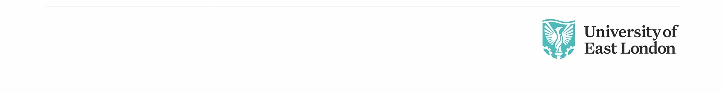
Lesson 8 CN4003: Introduction to JavaScript for web programming
Dr Fadi Safieddine
1
Dr. Fadi Safieddine copyright 2021

Slide 2

Lecture content:
Intro to JavaScript
Basic Language commands
Variables
Operators
Operations.
Introductions to functions
Handling Events
Connecting Applets.
2
Notes:
5
5

Slide 3
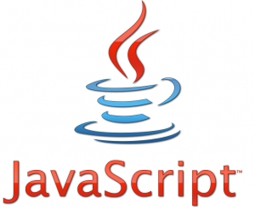
Introduction:
What is JavaScript:
Sun's simple, cross-platform, WWW scripting language adopted from Java.
Why was JavaScript invited?
Used to make web pages interactive.
Makes static HTML more responsive.
Used to do client-side and server-side scripting:
We will be only focusing on client side.
We can continue to use ++Notepad and the browsers to view the work.
You do not need any additional software.
3
Notes:
7
7

Slide 4
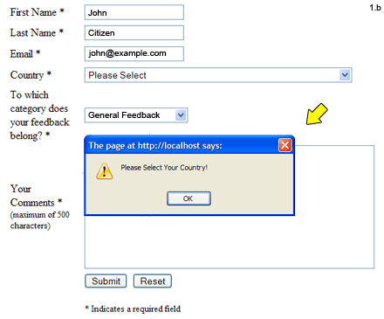
Client-Side Scripting:
4

Slide 5
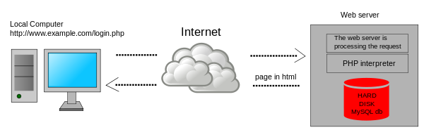
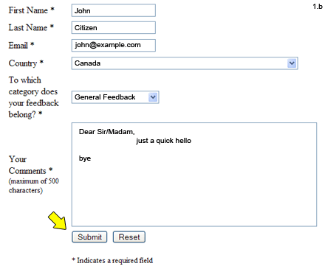
Server-Side Scripting
5

Slide 6
When do we use JavaScript?
Client-Side Scripting:
Custom website pages for the users
Perform calculations and make pages more interactive
Processes on the page.
Create special display effects.
Server-Side Scripting:
Process forms
Generate pages with custom or live content.
6
Notes:
10
10

Slide 7
JavaScript and HTML
JavaScript can be linked to an HTML document in three ways:
1. Inline the document using the SCRIPT tag.
2. Embedded as a function that is called by an event in the HTML document.
3. External as a separate Javascript file that you link to your HTML document.
7
Notes:
11
11

Slide 8
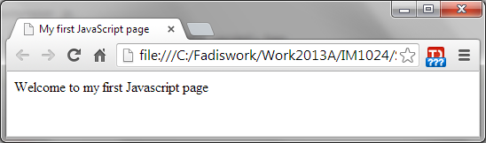
Example: Inline
<HTML>
<HEAD>
<TITLE> My first JavaScript page </TITLE>
</HEAD>
<BODY>
<SCRIPT LANGUAGE="JavaScript">
document.write("<P>Welcome to my first Javascript page </P>");
// This page will print one line and move to the next line.
</SCRIPT>
</BODY>
</HTML>
Comment
8
Notes:
12
12

Slide 9
End of Part 1
Activity 8.1. What is the difference between client-side scripting and server-side scripting? (select the true statements)
Client side scripting runs on home computer.
Server side scripting runs on the computer but also connects to the server.
Client side scripting can process login and credit card transitions.
Server side scripting process logins and credit card transactions.

Slide 10
JavaScript and HTML
Part 2
10
Notes:
11
11

Slide 11
Example: Inline
<SCRIPT> and </SCRIPT> tags contain the JavaScript instructions.
<SCRIPT LANGUAGE="JavaScript">
document.write("<P>Welcome to my first Javascript page </P>");
// This page will print one line and move to the next line.
</SCRIPT>
You could put the tags within the HTML<HEAD>
It will still work fine.
11
Notes:
13
13

Slide 12
Variables in JavaScripts
document.write is a command to write a string on an HTML document.
This can be used to write outcome of variable.
Examples:
<script>
Order= 1250;
document.write("<h3> Your order is £"+Order+"</h3>");
</script>
<script>
document.write("<IMG SRC=‘myphoto.jpg’>");
</script>
The + sign is used to combined
String and Variable outcome.
12
Notes:
14
14

Slide 13
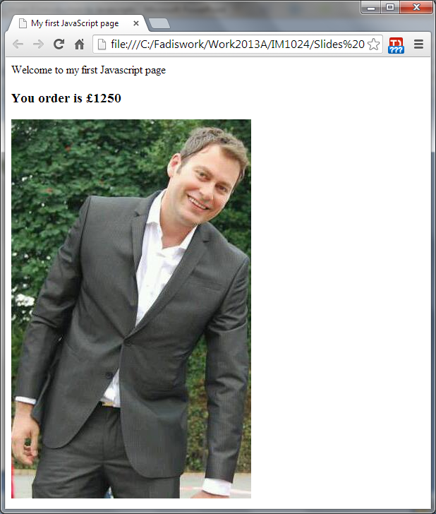
Outcome:
13

Slide 14
Comments in JavaScript:
<SCRIPT>
<!– This web page is just a demonstration purposes. The £1250 refers to the price of the suit! -->
// Not really it was a random figure.
</SCRIPT>
14
Notes:
15
15

Slide 15
JavaScript Variable types:
Integers:
1, 200, -99, 1,000,000
Floats:
1.5, 2400.00, -16.78
Boolean:
True / False
Strings
“My name is”, ‘Fadi’
Null
Denoting null value
15

Slide 16
JavaScript Operations:
We use = to assign an operation:
X = 700; X,Y= 0; (this means X and Y are zero)
Z = Null;
Z = X + Y;
Operations:
x = x + y ;
x = x - y ;
x = x * y ;
x = x / y ;
x = x + 1; Also 1++;
Remember JavaScript is Case Sensitive X does not equal to x.
16

Slide 17
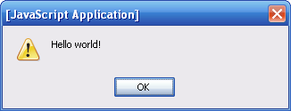
JavaScript Commands: Basic
alert
Pop up dialog box with a message and an OK button. Can contain variables or calculations.
Syntax: alert("message");
Example: alert(“Did you forgot to put your password?”);
alert(“Order is=“+Order); // The order will be displayed here.
17

Slide 18
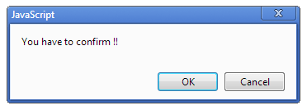
JavaScript Commands: Basic
confirm
Pop up dialog box with the specified message and OK and Cancel buttons. Returns a value of true or false.
Syntax: confirm("message");
Example: Response = confirm(“Are you sure you want to end the game?”);
Response will return true if OK is clicked or false if Cancel is clicked
18

Slide 19
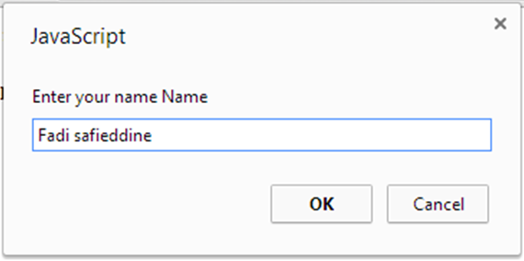
JavaScript Commands: Basic
prompt
Pop up message that expects an input.
Syntax: prompt(“message”) or prompt(“message”, initial value)
Value returned is a ‘String’. If we wish to convert it to a number, we use: parseFloat() or parseInt().
19

Slide 20
JavaScript Commands: Basic
Example:
InputName = prompt("Enter your name Name");
InputOrder = prompt("Enter your Order total",0);
PreVatOrder = parseFloat(InputOrder);
IncludeVatOrder = PreVatOrder + 0.2*PreVatOrder;
document.write(" <p> Dear "+InputName+", thank you for your order. Your order before tax is £"+PreVatOrder+" and after tax £"+IncludeVatOrder+". </br> please visit us soon.</p>");
20

Slide 21
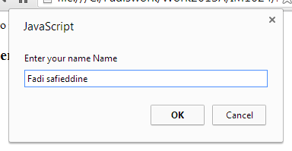
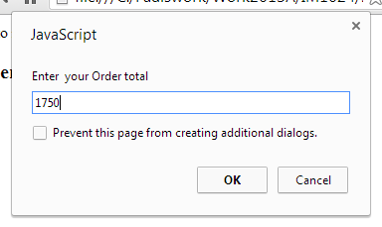
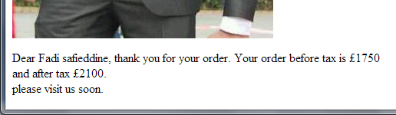
Output:
21

Slide 22
End of Part 2
Lab Activity 8.1. Open JavaScriptpage1.html from the folder of practicing and do the following:
Set the new tax rate at 0.25.
Add another prompt that asks for the address.
You can then print the address either on the top of the page or on the bottom of the page.
Save your work.

Slide 23
JavaScript Statements:
Part 3
23

Slide 24
JavaScript Statements:
Variable Declaration / Assignment
IF Statements (Conditional Statements)
Repeat Statements:
for loop
while loop
24

Slide 25
JavaScript: IF Statements
Syntax
if (condition) {
statements
} else {
else statements
}
Examples
if ( TotalOrder> 5000) {
SpecialOffer = 0.2; // 20% discount
} else {
SpecialOffer = 0.1; // 10% discount }
TotalOrder = TotalOrder- SpecialOffer*TotalOrder;
25

Slide 26
JavaScript: Conditional
== (Equality check)
!= (Inequality Check)
<, <=, =>, > (Arithmetic and String Comparison)
! (Logical Not)
&& (Logical AND)
|| (Logical OR)
26

Slide 27
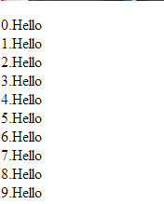
JavaScript: Repeats or Loops
Allowed to repeat/loop a statement until a certain condition is satisfied:
For Loop:
Example:
for (var i = 0; i < 10; i++) {
document.write(i+".Hello </br>");
}
Start Point
Condition
Counter
(i=i+1)
27

Slide 28
JavaScript: Repeats or Loops
While Loop: Similar to For loop but used when we do not know the number of repeats.
Syntax
while (condition) {
statements
}
Example:
Response= "N";
Count1=1;
while ( Response=="N" ) {
document.write(Count1+". Hello </br>");
Count1++;
Response = prompt("Do you want to Quit? Y/N","N"); }
28

Slide 29
End of Part 3
Lab Activity 8.2: Open JavaScriptpage2.html. Edit the code as following:
Remove the ‘hello’ BR from the JavaScript – the line in the code.
Replace it with Asterix (*)
Replace the prompt question with “Is this enough stars for the module?”
Press OK for five times.
Save the work.

Slide 30
JavaScript: Event Handling
Part 4
30

Slide 31
JavaScript: Event Handling
JavaScript provides event detection to pass control to JavaScript code attached to built-in event handlers
Syntax:
<INPUT type=“button” VALUE=“Calculate” onClick=“DoSomething()”>
These events are triggered by the user and do not run automatically.
31

Slide 32
JavaScript: Event Handling
Some of the most common event handling:
onChange
onClick
onDragDrop
onError
onFocus
onKeyDown
onKeyPress
onKeyUp
onLoad
onMouseOver
onMouse down/up
onMove
onReset
onResize
onSelect
onSubmit
32

Slide 33
JavaScript: Event Handling
onChange
A change event occurs when a select, text, or textarea field loses focus and its value has been modified.
onClick
A click event occurs when an object on a form is clicked.
onDragDrop
A drapDrop event occurs when a user drops an object onto the browser window, such as dropping a file on the browser window
onFocus
A focus event occurs when a field receives input focus by tapping with the keyboard or clicking with the mouse.
onKeyDown, onKeyPress, onKeyUp
A keyDown, keyPress, or keyUp event occurs when a user depresses a key, presses or holds down a key, or releases a key, respectively
33

Slide 34
JavaScript: Event Handling
onSelect
A select event occurs when a user selects some of the text within a text or textarea field.
onSubmit
A submit event occurs when a user submits a form
onUnload
An unload event occurs when you exit a document.
34

Slide 35
JavaScript: Event Handling
<!doctype>
<HTML>
<Head>
<Title> Even Handling with JavaScripts </Title>
<script language="JavaScript">
function ClickMessage()
{
alert("You have successfully created on click event!");
}
</script>
</Head>
<Body>
<form onSubmit="return ClickMessage()">
<input type="submit" name="Mybutton" value="ClickMe!" >
</form>
</Body>
</HTML>
35

Slide 36
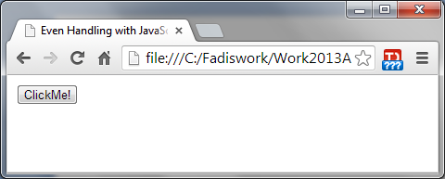
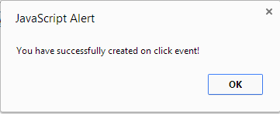
Outcome:
36

Slide 37
JavaScript: Event Handling
onLoad
A load event occurs when browser finishes loading a window.
Examples
In the following example, the onLoad event handler displays a greeting message after a web page is loaded.
<BODY onLoad="window.alert('Welcome to my home page!')">
onMouseDown, onMouseMove, onMouseOut, onMouseOver, and onMouseUp
A MouseDown, MouseMove, MouseOut, MouseOver, or MouseUp event occurs when a user depresses a mouse button, moves a cursor, moves a cursor out of a link or image map, moves a cursor over a link, releases a mouse button, respectively
37

Slide 38
JavaScript: Event Handling
OnResize
A Resize event occurs when a user or script resizes a window
A simple example: Pop up message on event handling.
38

Slide 39
JavaScript: Event Handling
<!doctype>
<HTML>
<Head>
<Title> Even Handling with JavaScripts </Title>
<script language="JavaScript">
window.onresize= AlertMessage;
function AlertMessage()
{
alert("The window has been resized!");
}
</script>
</Head>
<Body>
Try to resize this window.
</Body>
</HTML>
39

Slide 40
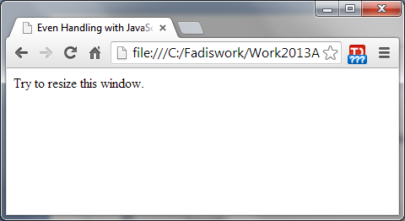
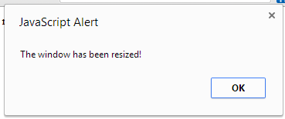
Outcome:

Slide 41
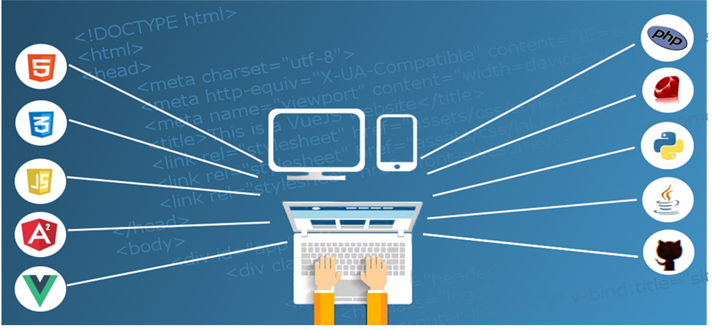
Where you should be now?
Everything you need to do your assignment has already been covered!!
This week and next two weeks cover knowledge that can ‘enhance’ your website and ‘enhance’ your grade.
You should be now progressing well in your assignment and ready for your feedback session with your tutor this week.
You have opportunity to submit in week 10 your web work for formative feedback.

Slide 42

Next lecture:
Recap on JavaScript
Learn how to create form check

Slide 43
End of Part 4
Activity 8.2. Explain the following on Events and what they mean:
onClick
onDragDrop
onFocus
onKeyDown
onLoad
Lab Practice 8.3. Include the ‘click me’ code that says ‘You have successfully created a click event’ to your earlier page.

